Slide 1
Wireless Communications seminar 02
Sungweon Hong
Information and Intelligent systems lab
Hanyang university
Department of Electronic Engineering

Slide 2
Contents
Review of Large-scale fading
Pathloss
Shadowing
Cell Planning
Small-scale fading (multi-path channel fading)
Time-varying impulse response
Coherence Bandwidth & Power Delay Profile
Coherence Time & Doppler spread spectrum

Slide 3
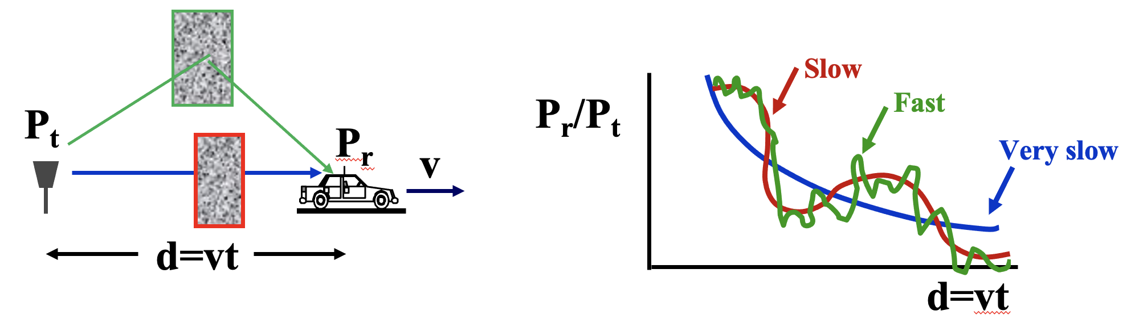
Review (Large-scale fading)
Path Loss
Signal power decrease by distance
Shadowing
Attenuation by obstacles
Multipath Fading
Reflection, diffraction, scattering
“Path loss” + ”Shadowing” + “Multipath”

Slide 4
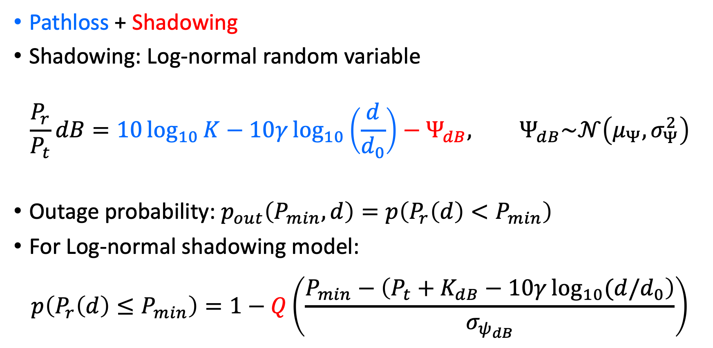
Review (Large-scale Fading)
Pathloss + Shadowing
Shadowing: Log-normal random variable
$$\frac{P_{r}}{P_{t}}dB=10\log_{10}{K}−10γ\log_{10}\left(\frac{d}{d_{0}}\right)−Ψ_{dB}, Ψ_{dB}\sim 𝒩\left(μ_{Ψ},σ_{Ψ}^{2}\right)$$
Outage probability: $p_{out}\left(P_{min},d\right)=p\left(P_{r}\left(d\right)<P_{min}\right)$
For Log-normal shadowing model:
$$p\left(P_{r}\left(d\right)≤P_{min}\right)=1−Q\left(\frac{P_{min}−\left(P_{t}+K_{dB}−10γ\log_{10}{(d/d_{0}}\right)}{σ_{ψ_{dB}}}\right)$$

Slide 5
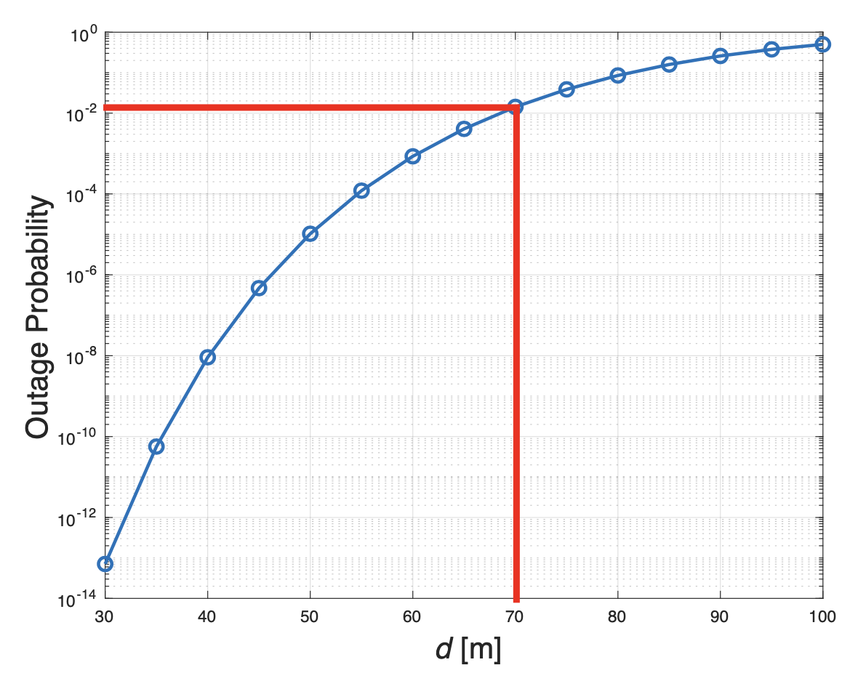
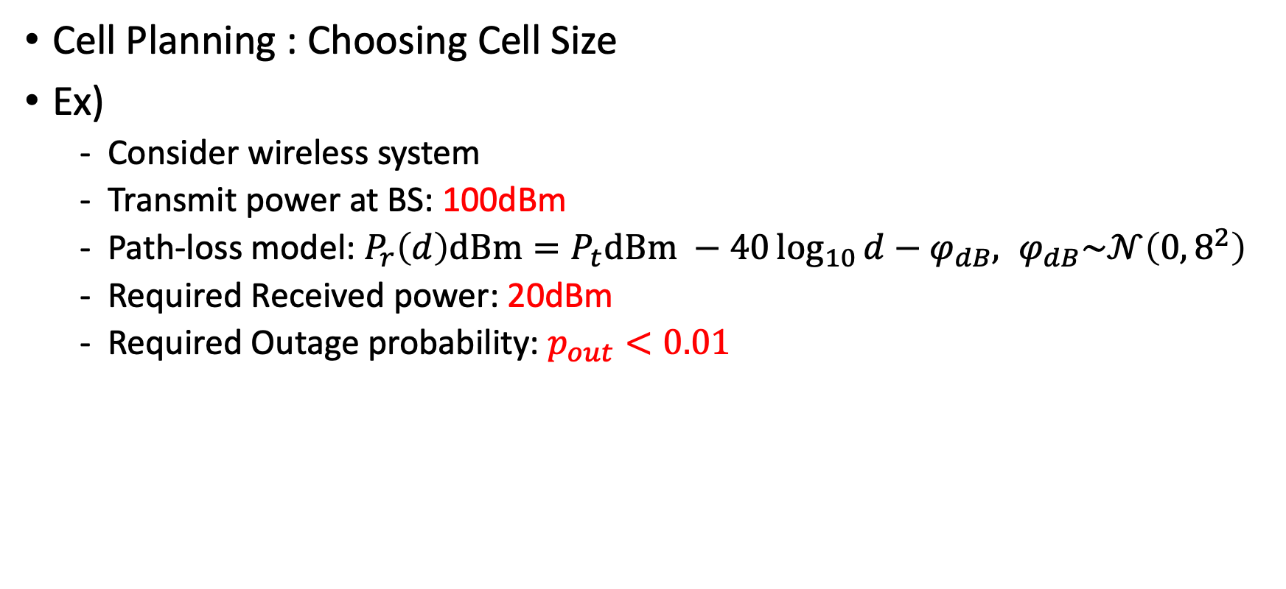
Review (Large-Scale Fading)
Cell Planning : Choosing Cell Size
Ex)
Consider wireless system
Transmit power at BS: 100dBm
Path-loss model: $P_{r}\left(d\right)dBm=P_{t}dBm −40\log_{10}{d}−φ_{dB}, φ_{dB}\sim 𝒩\left(0, 8^{2}\right)$
Required Received power: 20dBm
Required Outage probability: $p_{out}<0.01$

Slide 6
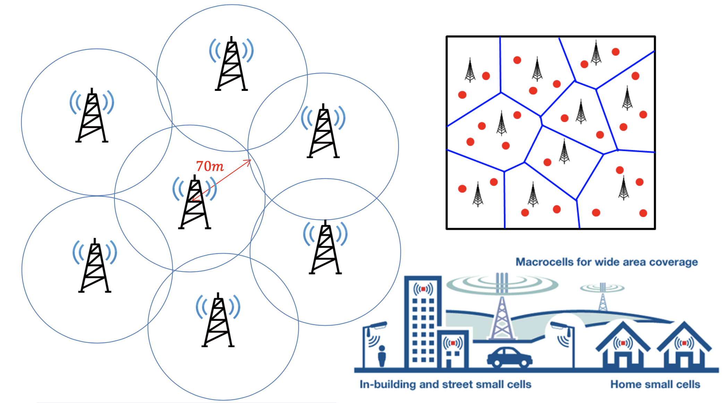
Review (Large-Scale Fading)

Slide 7
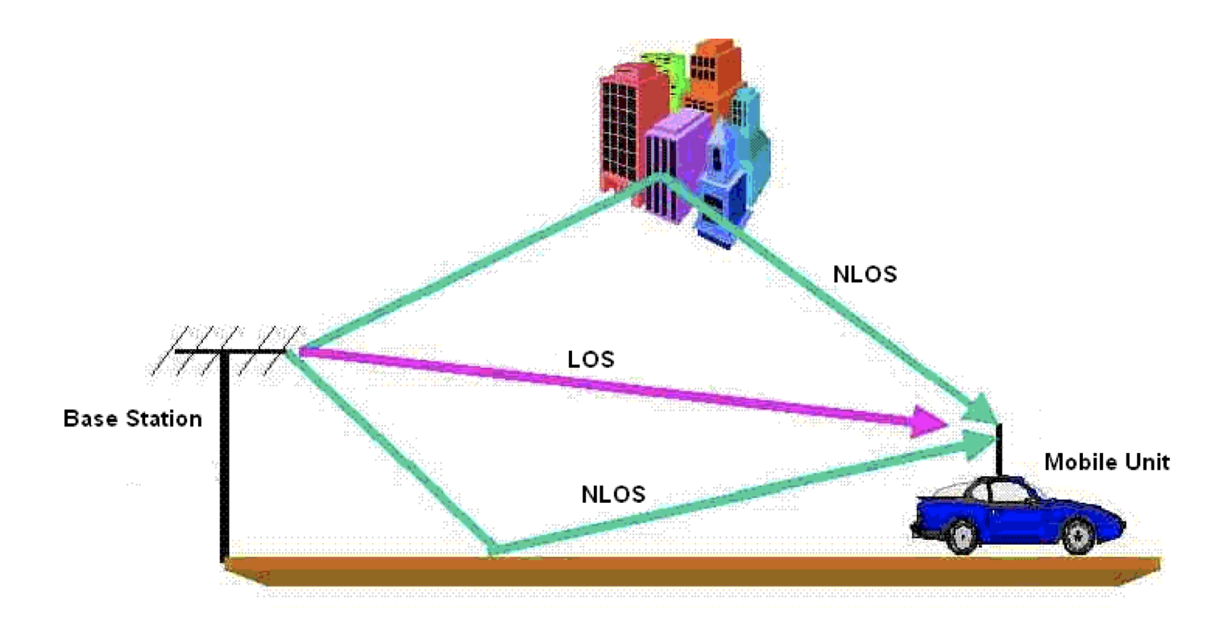
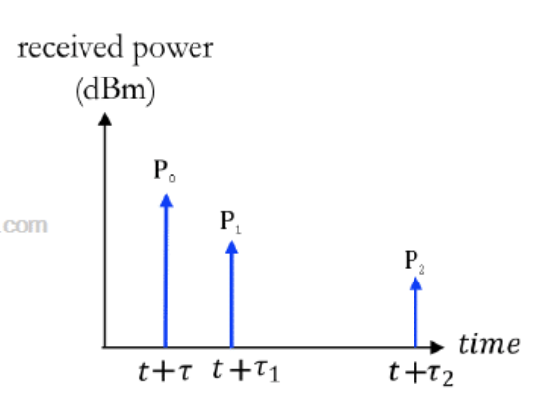
Multipath Model
Multipath Fading
Constructive and destructive effects of different multipath components introduced by the channel
Time-Varying Channel impulse response

Slide 8
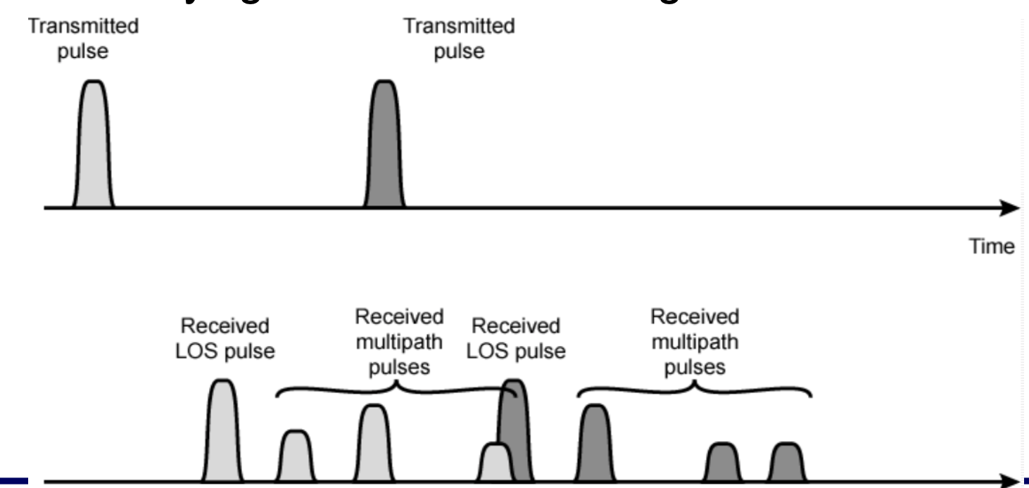
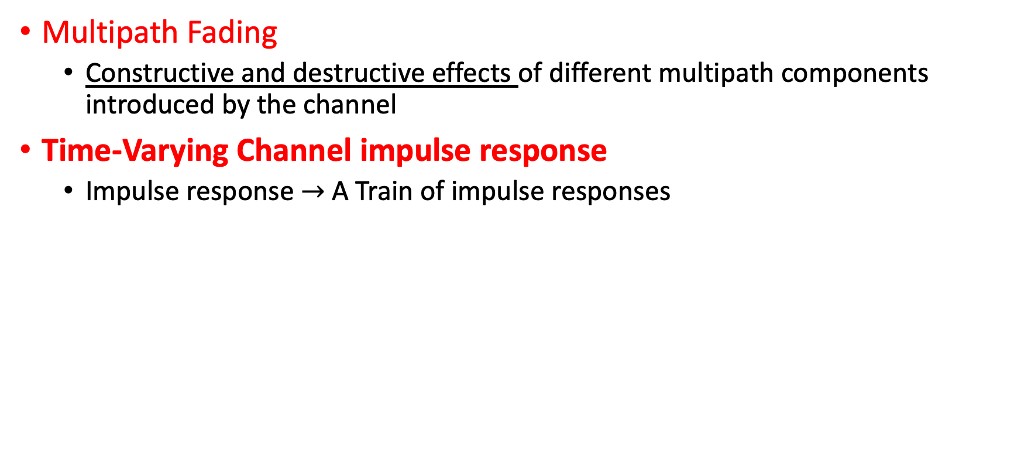
Multipath Model
Multipath Fading
Constructive and destructive effects of different multipath components introduced by the channel
Time-Varying Channel impulse response
Impulse response $→$ A Train of impulse responses
Symbol duration

Slide 9
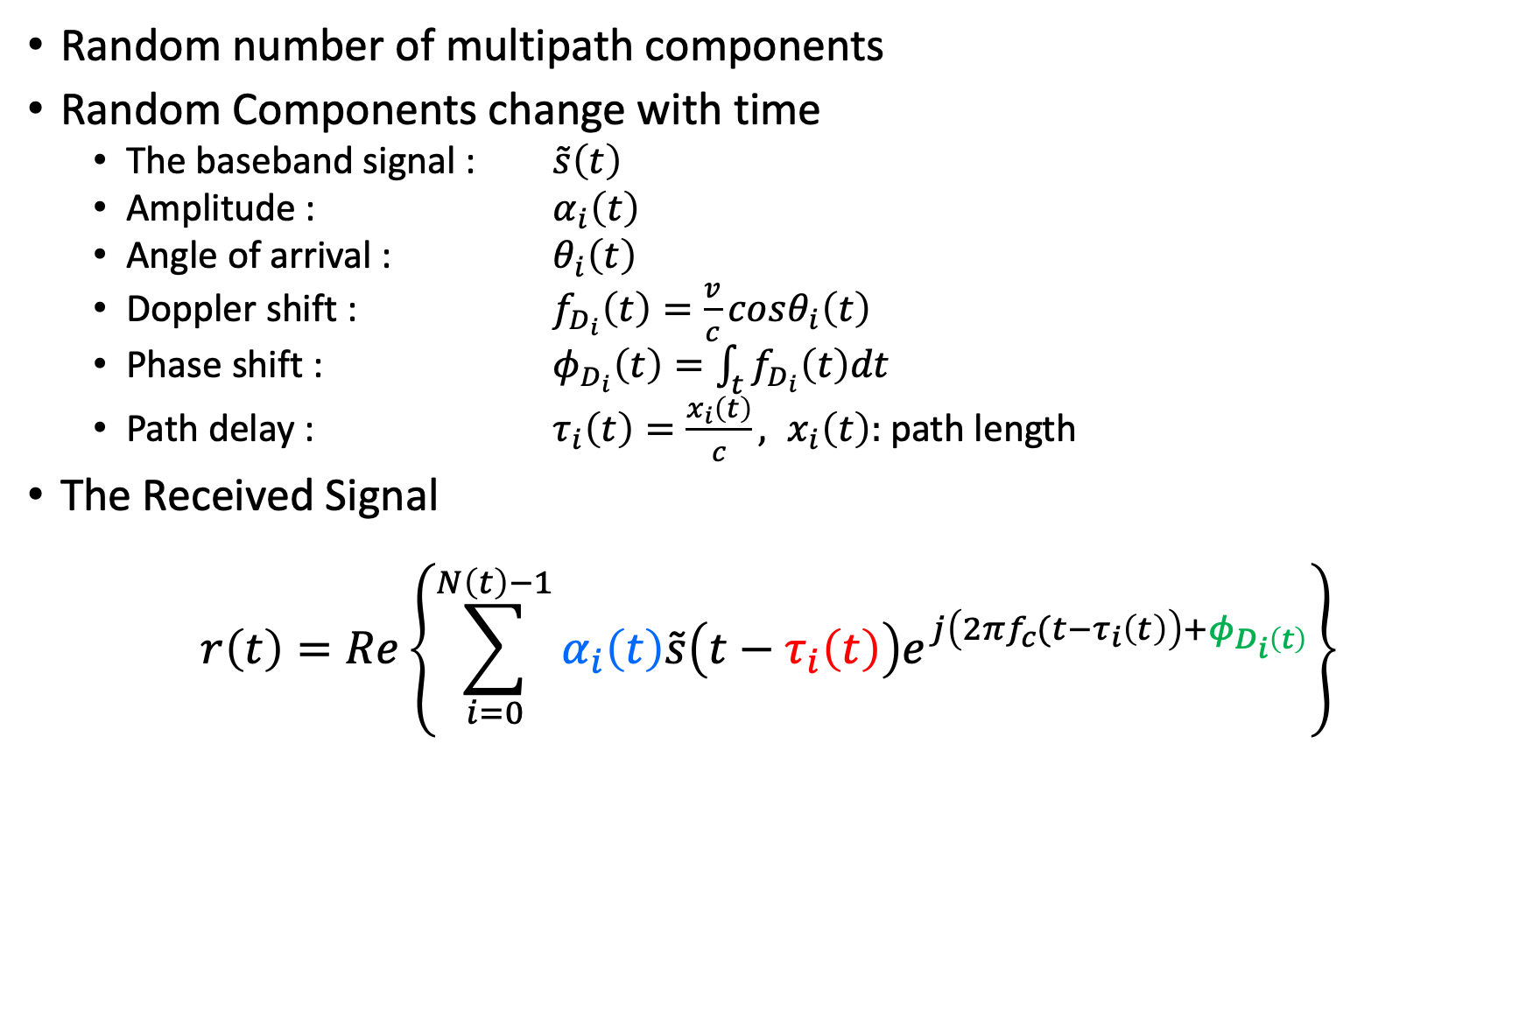
Statistical Multipath Model
Random number of multipath components
Random Components change with time
The baseband signal : $\tilde{s}\left(t\right)$
Amplitude : $α_{i}\left(t\right)$
Angle of arrival : $θ_{i}\left(t\right)$
Doppler shift : $f_{D_{i}}\left(t\right)=\frac{v}{c}cosθ_{i}\left(t\right)$
Phase shift : $φ_{D_{i}}\left(t\right)=\int_{t}{f_{D_{i}}\left(t\right)dt}$
Path delay : $τ_{i}\left(t\right)=\frac{x_{i}\left(t\right)}{c}, x_{i}\left(t\right):$ path length
The Received Signal
$$r\left(t\right)=Re\left\{\sum_{i=0}^{N\left(t\right)−1}{α_{i}\left(t\right)\tilde{s}\left(t−τ_{i}\left(t\right)\right)e^{j\left(2πf_{c}(t−τ_{i}\left(t\right)\right)+φ_{D_{i}\left(t\right)}}}\right\}$$
Pathloss, Shadowing
delay
Doppler

Slide 10
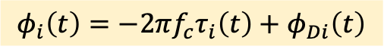
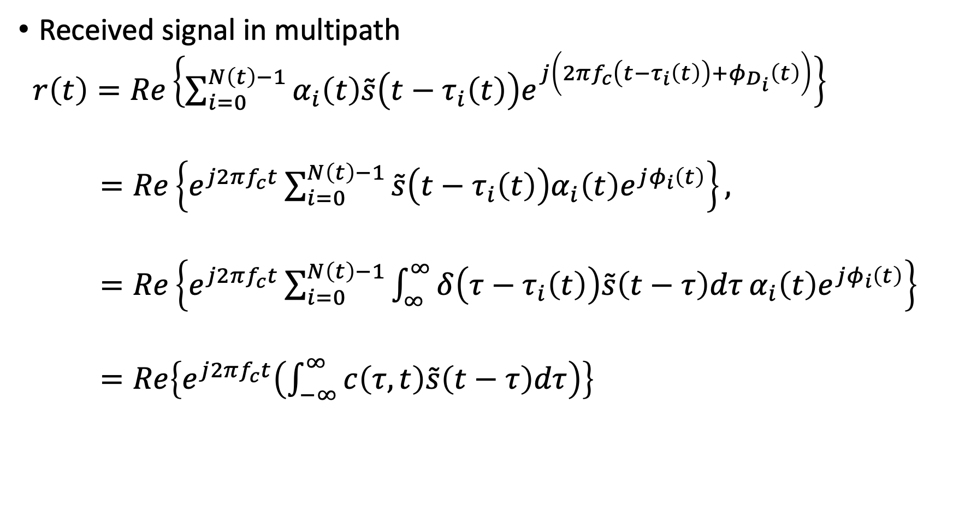
Time-varying Impulse Response
Received signal in multipath
$r\left(t\right)=Re\left\{\sum_{i=0}^{N\left(t\right)−1}{α_{i}\left(t\right)\tilde{s}\left(t−τ_{i}\left(t\right)\right)e^{j\left(2πf_{c}\left(t−τ_{i}\left(t\right)\right)+φ_{D_{i}}\left(t\right)\right)}}\right\}$
$=Re\left\{e^{j2πf_{c}t}\sum_{i=0}^{N\left(t\right)−1}{\tilde{s}\left(t−τ_{i}\left(t\right)\right)α_{i}\left(t\right)e^{jφ_{i}\left(t\right)}}\right\},$
$=Re\left\{e^{j2πf_{c}t}\sum_{i=0}^{N\left(t\right)−1}{\int_{∞}^{∞}{δ\left(τ−τ_{i}\left(t\right)\right)\tilde{s}\left(t−τ\right)dτ}}α_{i}\left(t\right)e^{jφ_{i}\left(t\right)}\right\}$
$=Re\left\{e^{j2πf_{c}t}\left(\int_{−∞}^{∞}{c\left(τ,t\right)\tilde{s}\left(t−τ\right)dτ}\right)\right\}$
$$φ_{i}\left(t\right)=−2πf_{c}τ_{i}\left(t\right)+φ_{Di}\left(t\right)$$
Sifting property

Slide 11
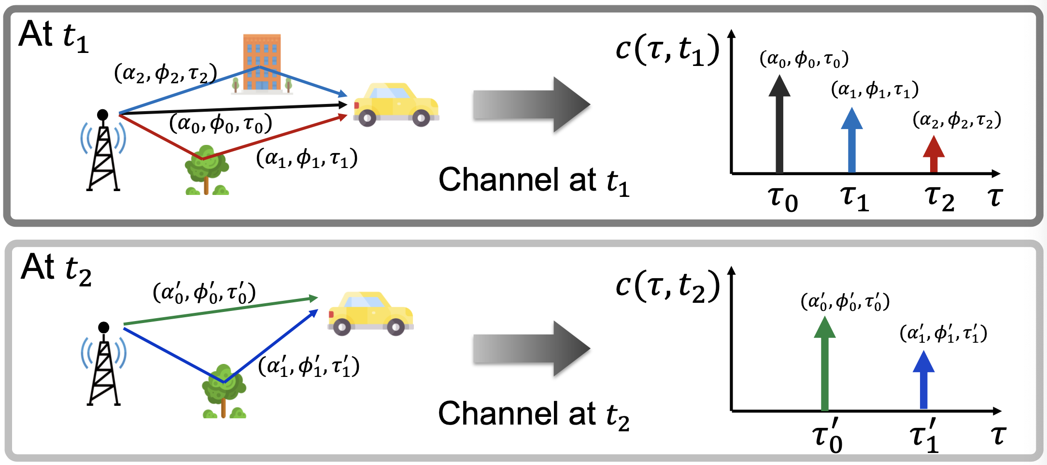
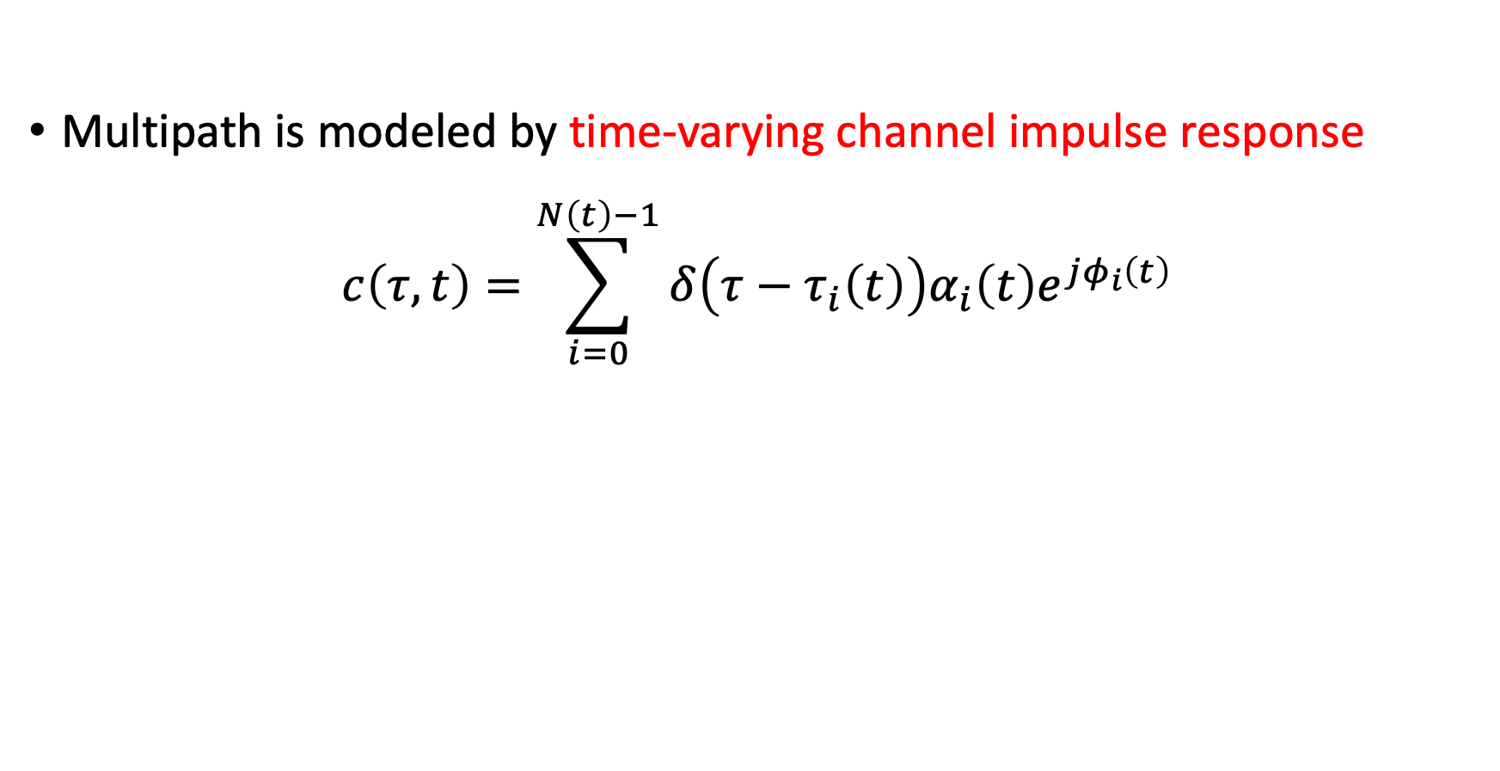
Time-varying Impulse Response
Multipath is modeled by time-varying channel impulse response
$$c\left(τ,t\right)=\sum_{i=0}^{N\left(t\right)−1}{δ\left(τ−τ_{i}\left(t\right)\right)α_{i}\left(t\right)e^{jφ_{i}\left(t\right)}}$$

Slide 12
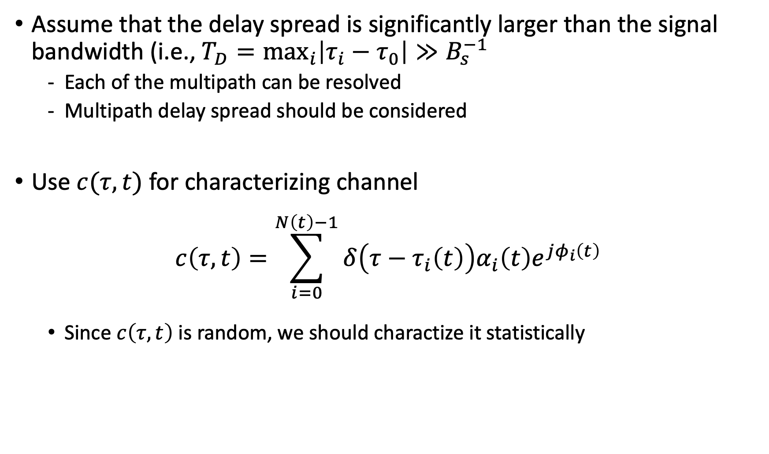
Wideband Model
Assume that the delay spread is significantly larger than the signal bandwidth (i.e., $T_{D}=\max_{i}\left|τ_{i}−τ_{0}\right|≫B_{s}^{−1}$
Each of the multipath can be resolved
Multipath delay spread should be considered
Use $c(τ, t)$ for characterizing channel
$$c\left(τ,t\right)=\sum_{i=0}^{N\left(t\right)−1}{δ\left(τ−τ_{i}\left(t\right)\right)α_{i}\left(t\right)e^{jφ_{i}\left(t\right)}}$$
Since $c\left(τ, t\right)$ is random, we should charactize it statistically

Slide 13
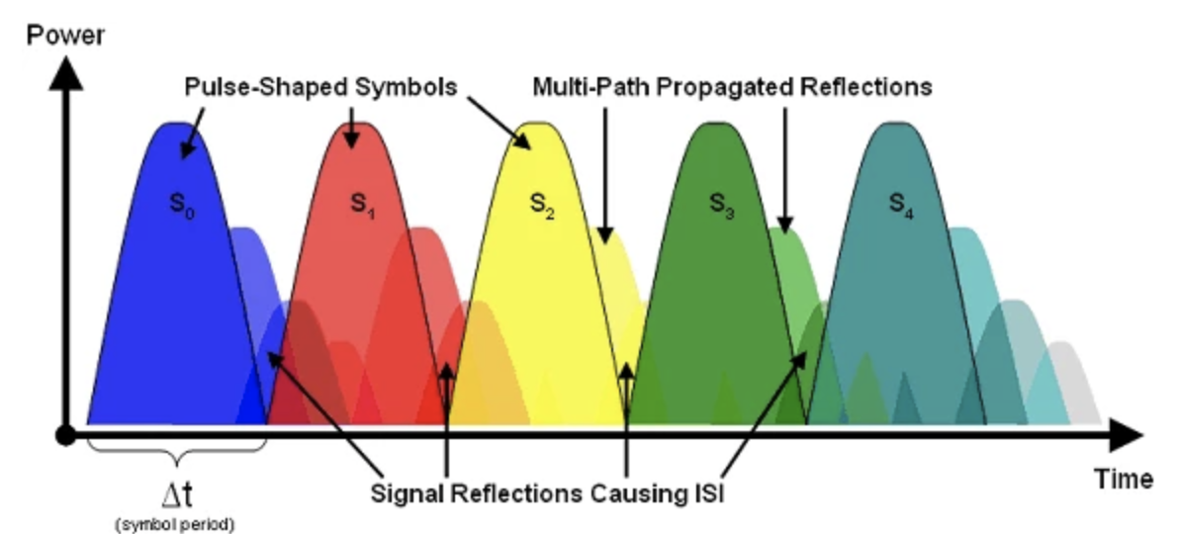
Wideband Model
An Intuition for ISI in wideband

Slide 14
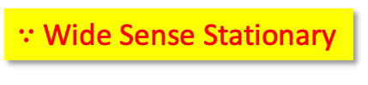
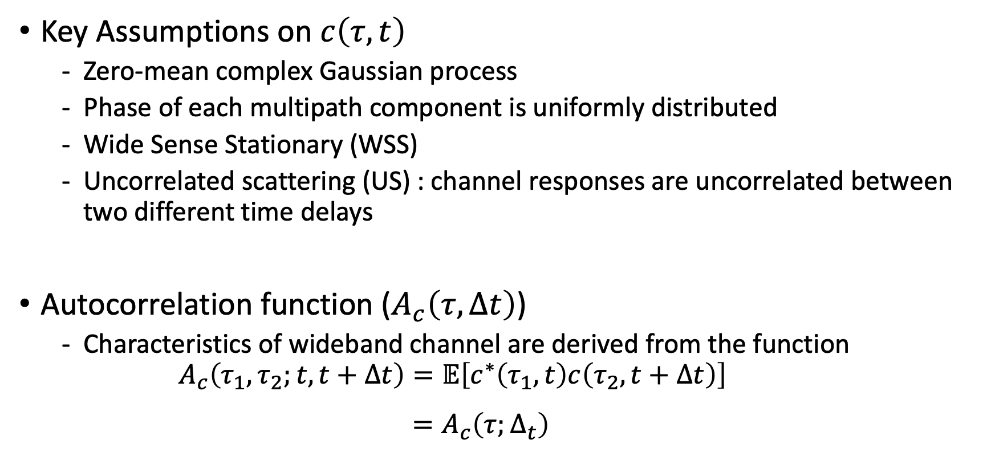
Wideband Model
Key Assumptions on $c\left(τ,t\right)$
Zero-mean complex Gaussian process
Phase of each multipath component is uniformly distributed
Wide Sense Stationary (WSS)
Uncorrelated scattering (US) : channel responses are uncorrelated between two different time delays
Autocorrelation function ($A_{c}\left(τ,Δt\right)$)
Characteristics of wideband channel are derived from the function
$$A_{c}\left(τ_{1},τ_{2};t, t+Δt\right)=𝔼\left[c^{∗}\left(τ_{1},t\right)c\left(τ_{2},t+Δt\right)\right]$$
$$=A_{c}\left(τ;Δ_{t}\right)$$
$∵$ Wide Sense Stationary

Slide 15
Wideband Model
Wideband Channel Characteristics
Power delay profile
Coherence bandwidth
Doppler spread
Coherence time

Slide 16
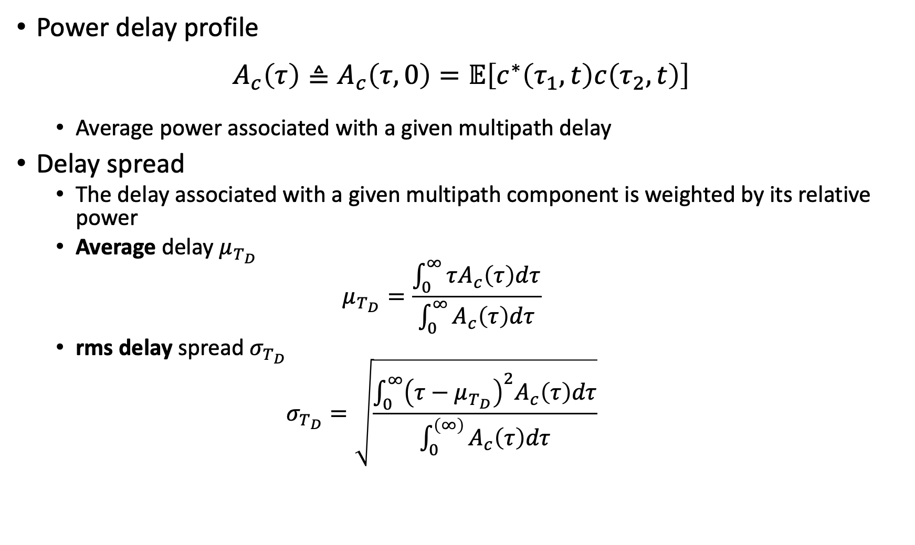
Coherence Bandwidth
Power delay profile
$$A_{c}\left(τ\right)≜A_{c}\left(τ, 0\right)=𝔼\left[c^{∗}\left(τ_{1}, t\right)c\left(τ_{2}, t\right)\right]$$
Average power associated with a given multipath delay
Delay spread
The delay associated with a given multipath component is weighted by its relative power
Average delay $μ_{T_{D}}$
$$μ_{T_{D}}=\frac{\int_{0}^{∞}{τA_{c}\left(τ\right)dτ}}{\int_{0}^{∞}{A_{c}\left(τ\right)dτ}}$$
rms delay spread $σ_{T_{D}}$
$$σ_{T_{D}}=\sqrt{\frac{\int_{0}^{∞}{{\left(τ−μ_{T_{D}}\right)}^{2}A_{c}\left(τ\right)dτ}}{\int_{0}^{\left(∞\right)}{A_{c}\left(τ\right)dτ}}}$$

Slide 17
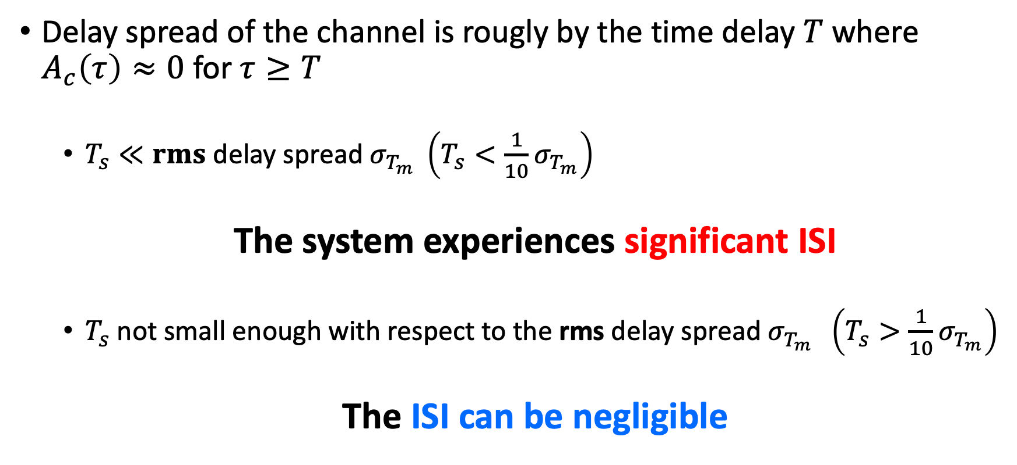
Coherence Bandwidth
Delay spread of the channel is rougly by the time delay $T$ where $A_{c}\left(τ\right)≈0$ for $τ≥T$
$T_{s}≪rms$ delay spread $σ_{T_{m}} \left(T_{s}<\frac{1}{10}σ_{T_{m}}\right)$
The system experiences significant ISI
$T_{s}$ not small enough with respect to the rms delay spread $σ_{T_{m}} \left(T_{s}>\frac{1}{10}σ_{T_{m}}\right)$
The ISI can be negligible

Slide 18
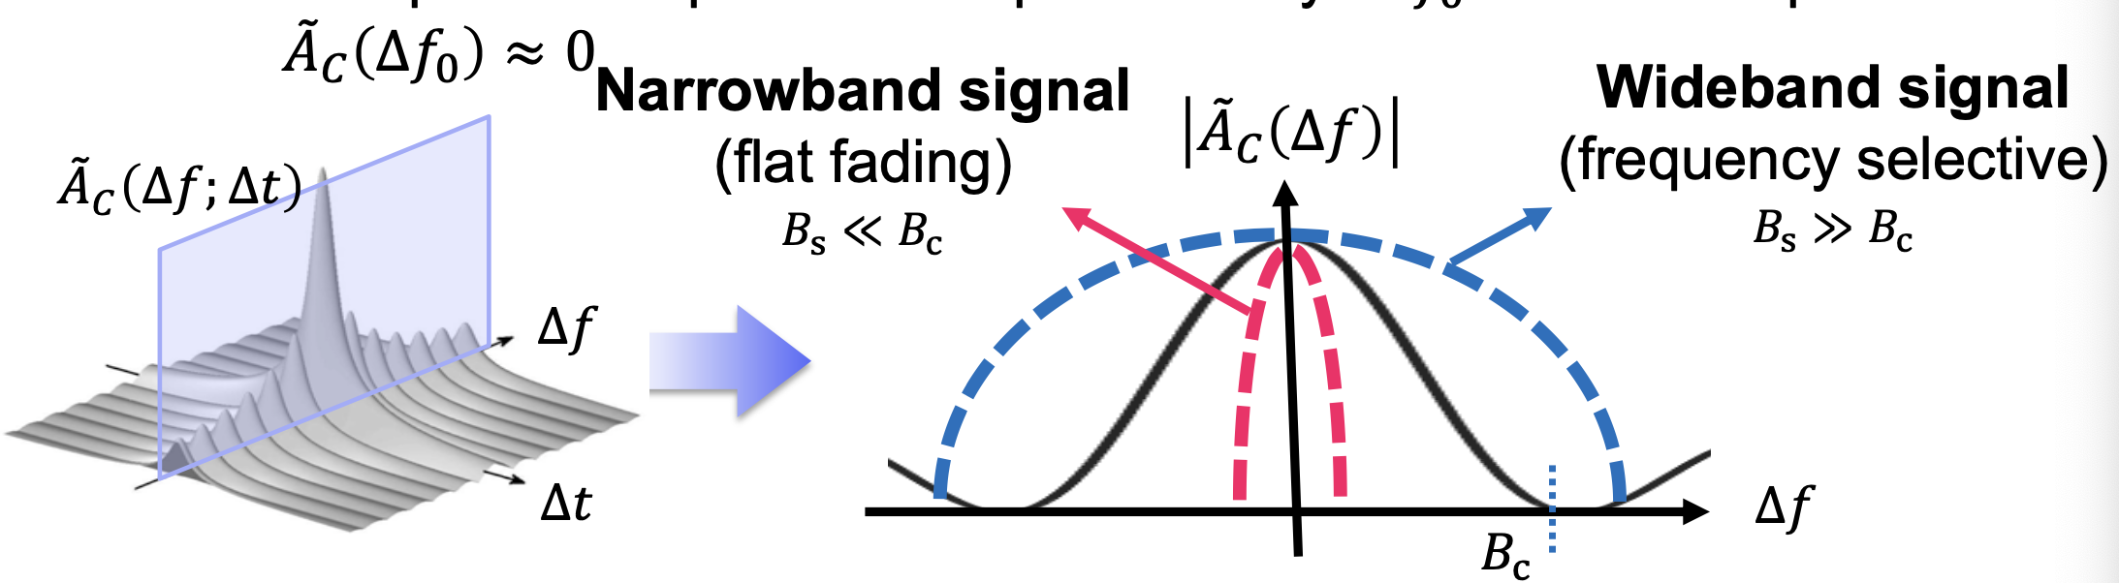
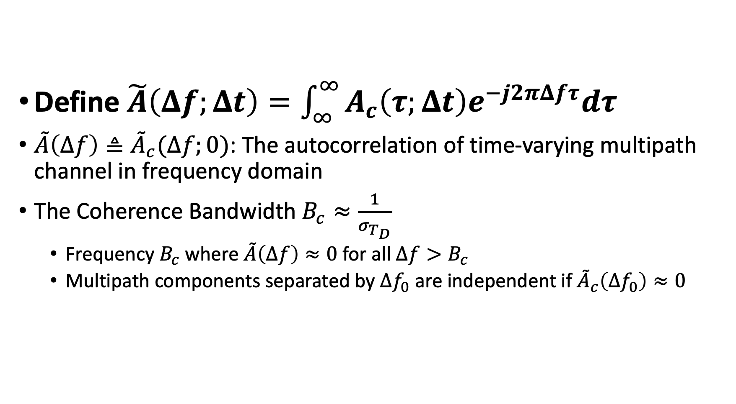
Coherence Bandwidth
Define $\tilde{A}\left(Δf;Δt\right)=\int_{∞}^{∞}{A_{c}\left(τ;Δt\right)e^{−j2πΔfτ}dτ}$
$\tilde{A}\left(Δf\right)≜{\tilde{A}}_{c}(Δf;0)$: The autocorrelation of time-varying multipath channel in frequency domain
The Coherence Bandwidth $B_{c}≈\frac{1}{σ_{T_{D}}}$
Frequency $B_{c}$ where $\tilde{A}\left(Δf\right)≈0$ for all $Δf>B_{c}$
Multipath components separated by $Δf_{0}$ are independent if ${\tilde{A}}_{c}\left(Δf_{0}\right)≈0$

Slide 19
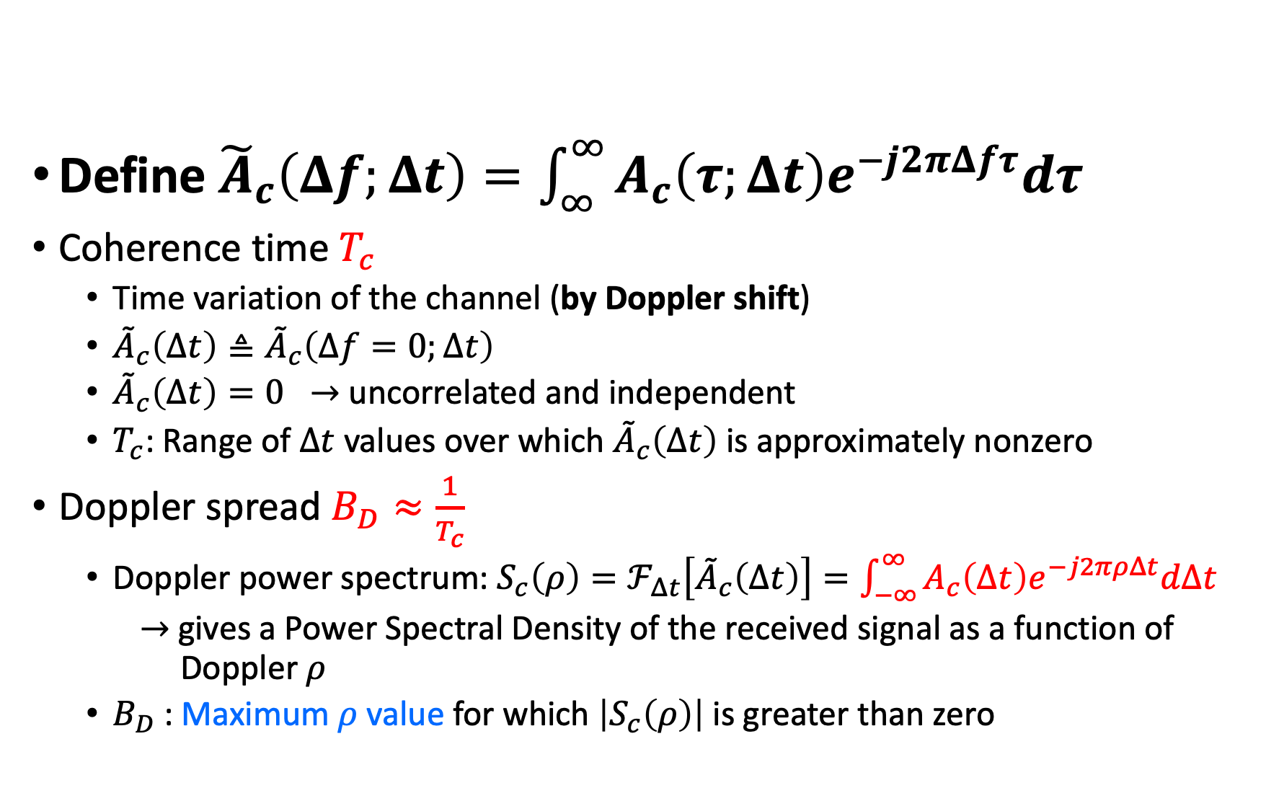
Coherence Time
Define ${\tilde{A}}_{c}\left(Δf;Δt\right)=\int_{∞}^{∞}{A_{c}\left(τ;Δt\right)e^{−j2πΔfτ}dτ}$
Coherence time $T_{c}$
Time variation of the channel (by Doppler shift)
${\tilde{A}}_{c}\left(Δt\right)≜{\tilde{A}}_{c}\left(Δf=0;Δt\right)$
${\tilde{A}}_{c}\left(Δt\right)=0 →$ uncorrelated and independent
$T_{c}$: Range of $Δt$ values over which ${\tilde{A}}_{c}\left(Δt\right)$ is approximately nonzero
Doppler spread $B_{D}≈\frac{1}{T_{c}}$
Doppler power spectrum: $S_{c}\left(ρ\right)=ℱ_{Δt}\left[{\tilde{A}}_{c}\left(Δt\right)\right]=\int_{−∞}^{∞}{A_{c}\left(Δt\right)e^{−j2πρΔt}dΔt}$
$→$gives a Power Spectral Density of the received signal as a function of Doppler $ρ$
$B_{D}$ : Maximum $ρ$ value for which $\left|S_{c}\left(ρ\right)\right|$ is greater than zero

Slide 20
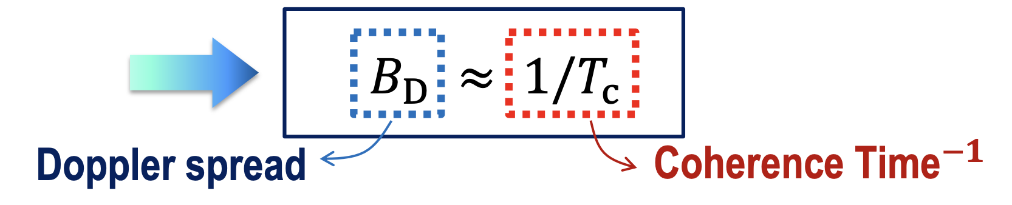
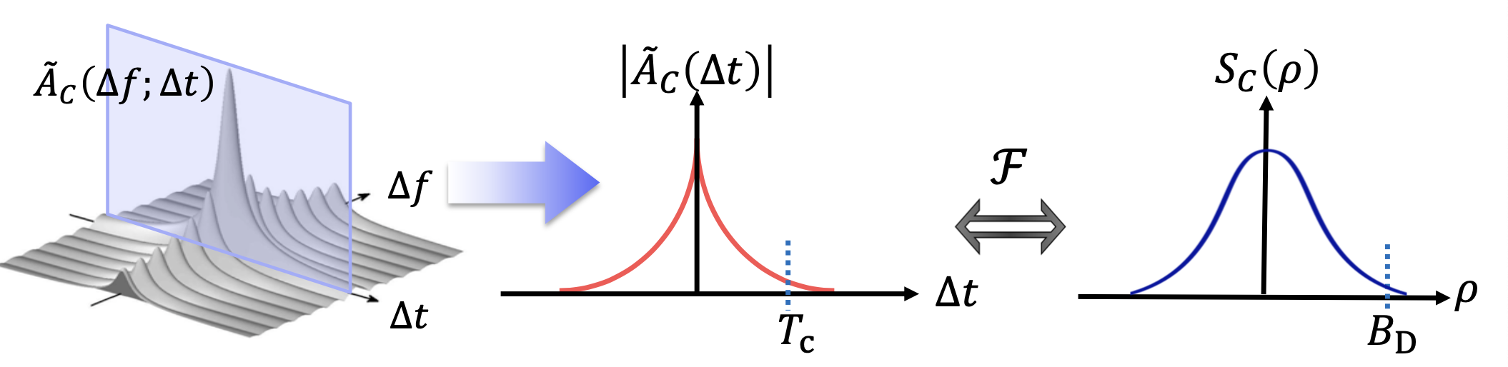
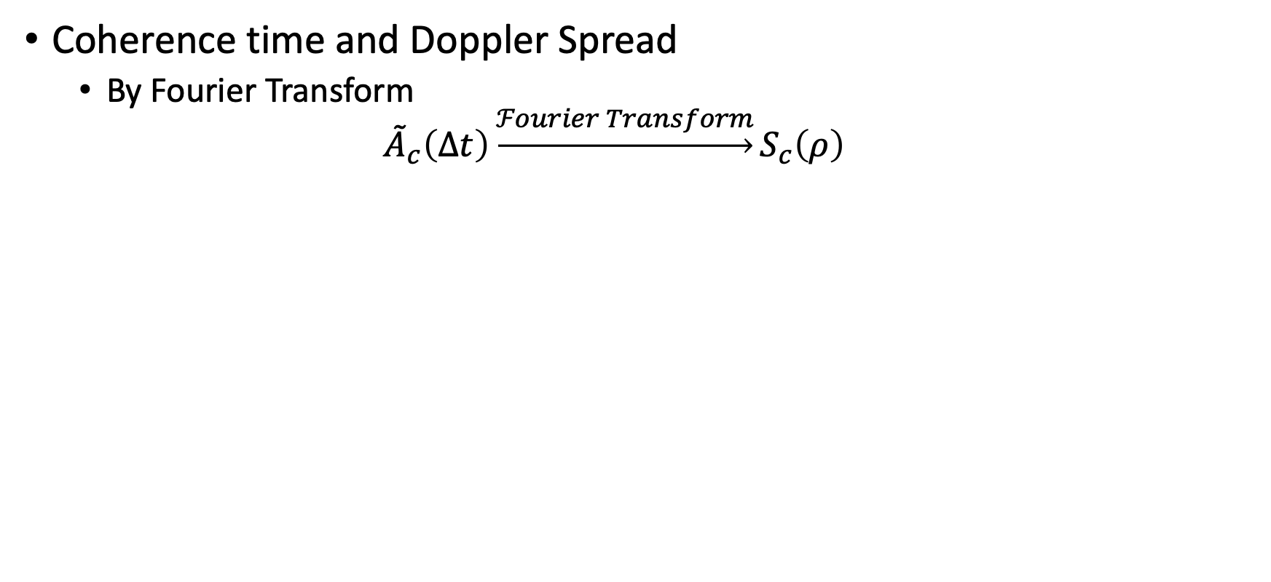
Coherence Time
Coherence time and Doppler Spread
By Fourier Transform
$${\tilde{A}}_{c}\left(Δt\right)\underset{→}{ℱourier Transform}S_{c}\left(ρ\right)$$

Slide 21
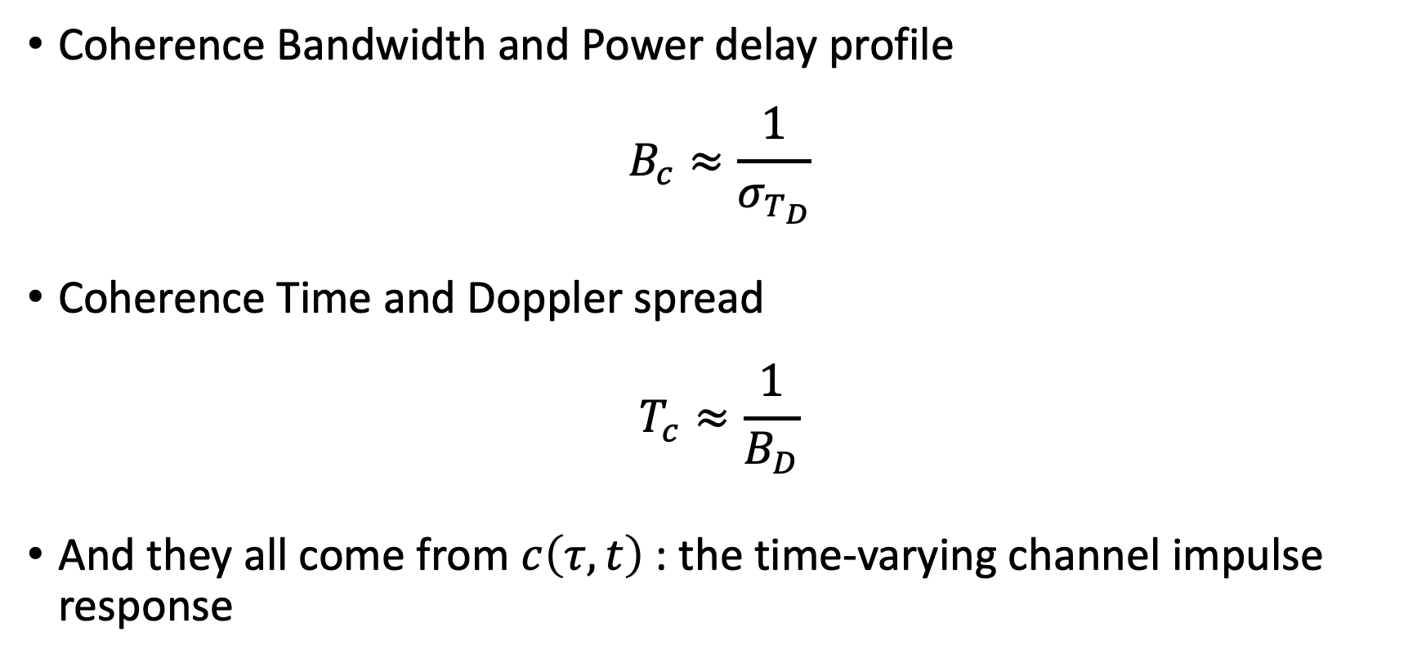
Summary
Coherence Bandwidth and Power delay profile
$$B_{c}≈\frac{1}{σ_{T_{D}}}$$
Coherence Time and Doppler spread
$$T_{c}≈\frac{1}{B_{D}}$$
And they all come from $c\left(τ, t\right)$ : the time-varying channel impulse response

Slide 22
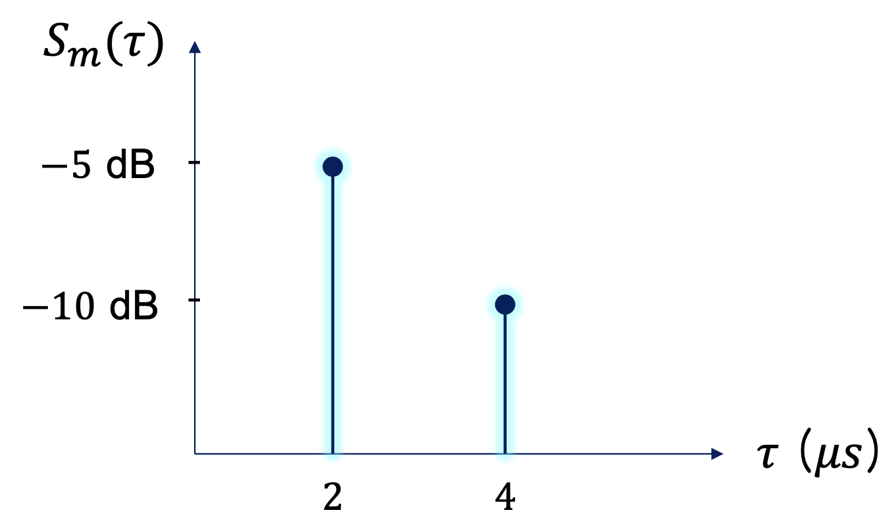
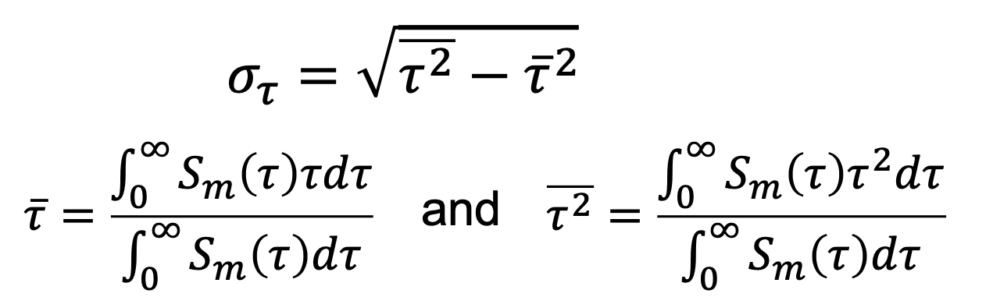
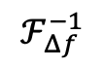
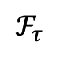
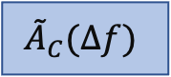

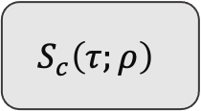
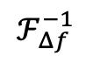
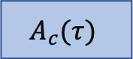

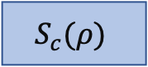
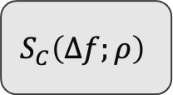
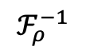
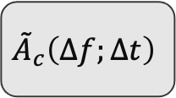
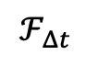
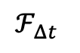
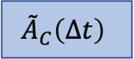
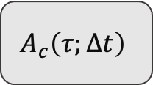
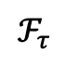
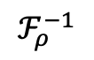
Summary
The Relationships of the Characteristics
$$Δt→0$$
Delay Spread
$$A_{c}(τ)$$
Power Delay Profile
Coherence Bandwidth
$$A_{c}\left(τ;Δt\right)$$
Autocorrelation function
$$ℱ_{τ}$$
$${\tilde{A}}_{C}(Δf)$$
$$ℱ_{ρ}^{−1}$$
$$ℱ_{Δf}^{−1}$$
$$ℱ_{Δt}$$
$${\tilde{A}}_{c}\left(Δf;Δt\right)$$
$$S_{c}\left(τ;ρ\right)$$
Scattering function
$$Δf→0$$
$${\tilde{A}}_{C}\left(Δt\right)$$
$$ℱ_{ρ}^{−1}$$
$$ℱ_{τ}$$
$$ℱ_{Δt}$$
$$ℱ_{Δf}^{−1}$$
$$S_{C}\left(Δf;ρ\right)$$
Coherence time
$$S_{c}(ρ)$$
Doppler Power Spectrum
Doppler Spread

Slide 23
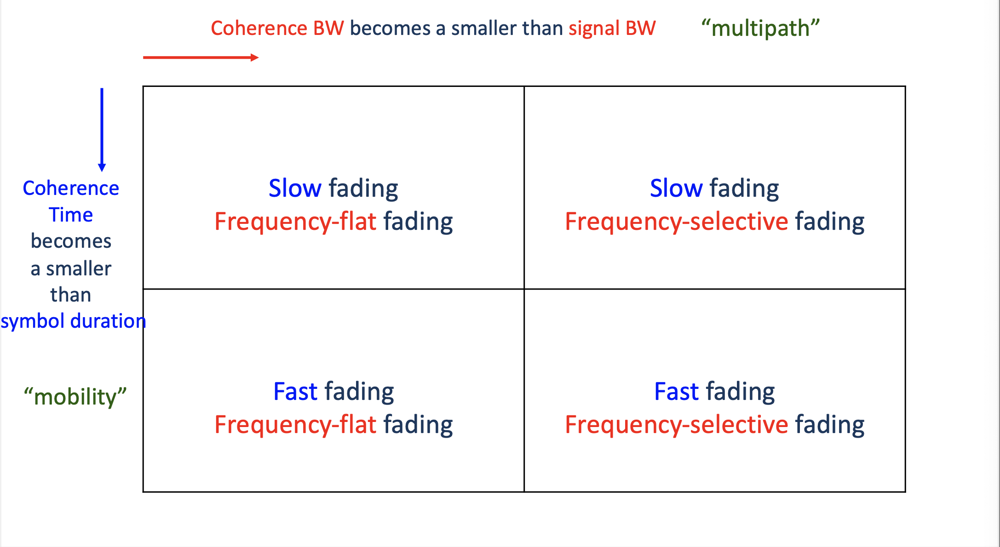
Summary

Slide 24
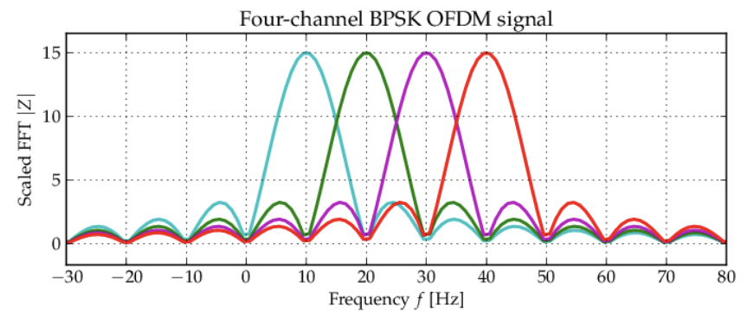
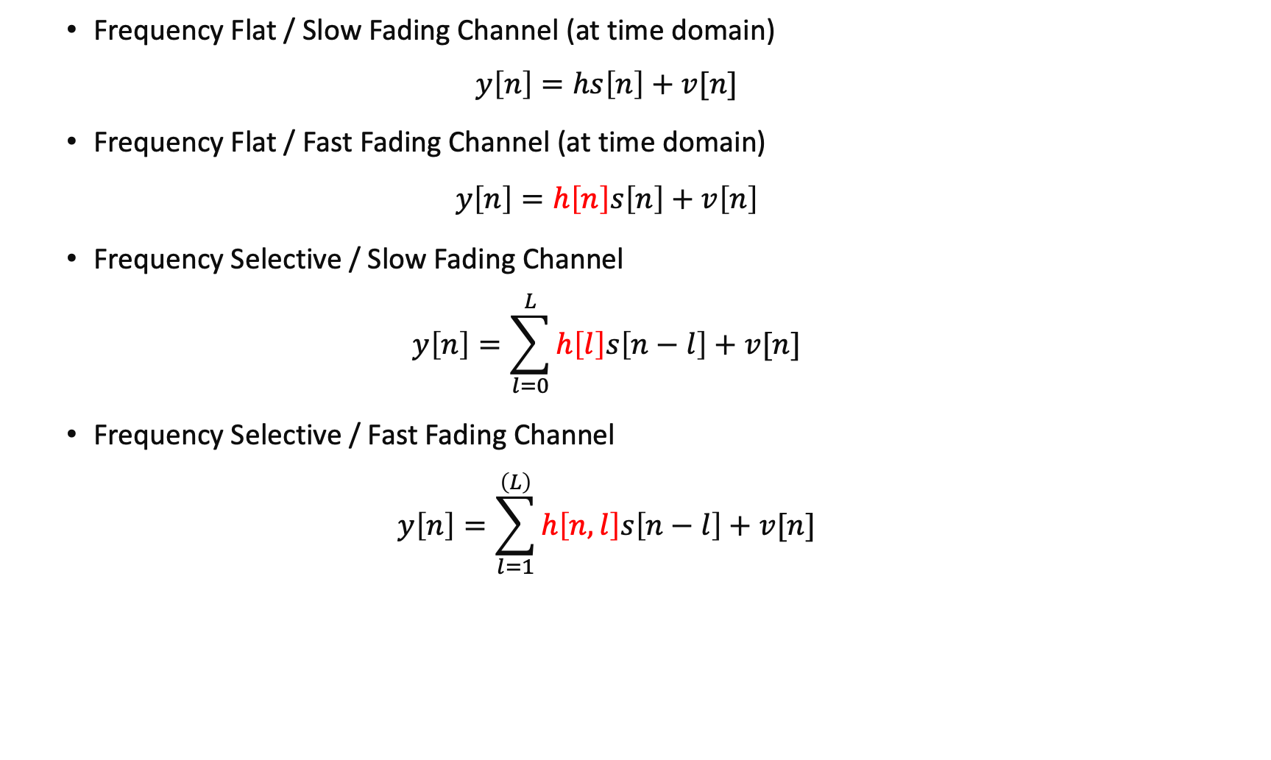
Discrete-Time Baseband Model
Frequency Flat / Slow Fading Channel (at time domain)
$$y\left[n\right]=hs\left[n\right]+v[n]$$
Frequency Flat / Fast Fading Channel (at time domain)
$$y\left[n\right]=h\left[n\right]s\left[n\right]+v\left[n\right]$$
Frequency Selective / Slow Fading Channel
$$y\left[n\right]=\sum_{l=0}^{L}{h\left[l\right]s\left[n−l\right]}+v[n]$$
Frequency Selective / Fast Fading Channel
$$y\left[n\right]=\sum_{l=1}^{\left(L\right)}{h\left[n,l\right]s\left[n−l\right]}+v[n]$$
Channel tracking via Wiener/Kalman filters
OFDM modulation
V2V Communications
Notes:
Breaking down widebands into frequency selective channel into several flat channels

Slide 25
References
ECE 432 Mobile Communications_Lecture2_Ajou_university lecture notes by S.N. Hong & W.J Shin
Goldsmith, Andrea. Wireless communications. Cambridge university press, 2005.

Slide 26
QnA

Slide 27
Thank you

